Slide 1

Team Venom

Slide 2

CONTENTS
01
07
13
Problem Statement
Competitive Advantage
Team
02
08
14
Solution
Budget
Partners
03
09
Market Opportunity
Our Adds
04
10
Technology
Income Statement
05
11
Business model
Revenue
12
06
Impact
Marketting Strategy

Slide 3
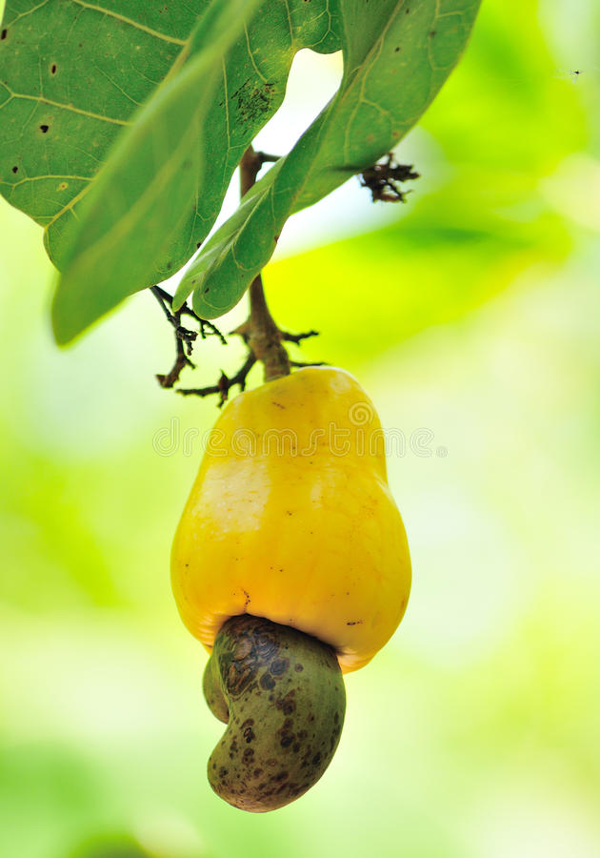

PROBLEM STATMENT
The lack of utilization of cashew apple

Slide 4
MARKET OPPORTUNITY
Health concerns
Rush for weight loss product
Global demand for green energy

Slide 5
SOLUTION
We will buy these apples from farmers
Cashew Apples
Pressing
Cashew Juice
fermentation
filteration
fiteration
packaging
distilation
packaging

Slide 6
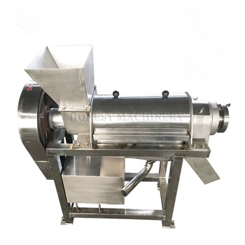


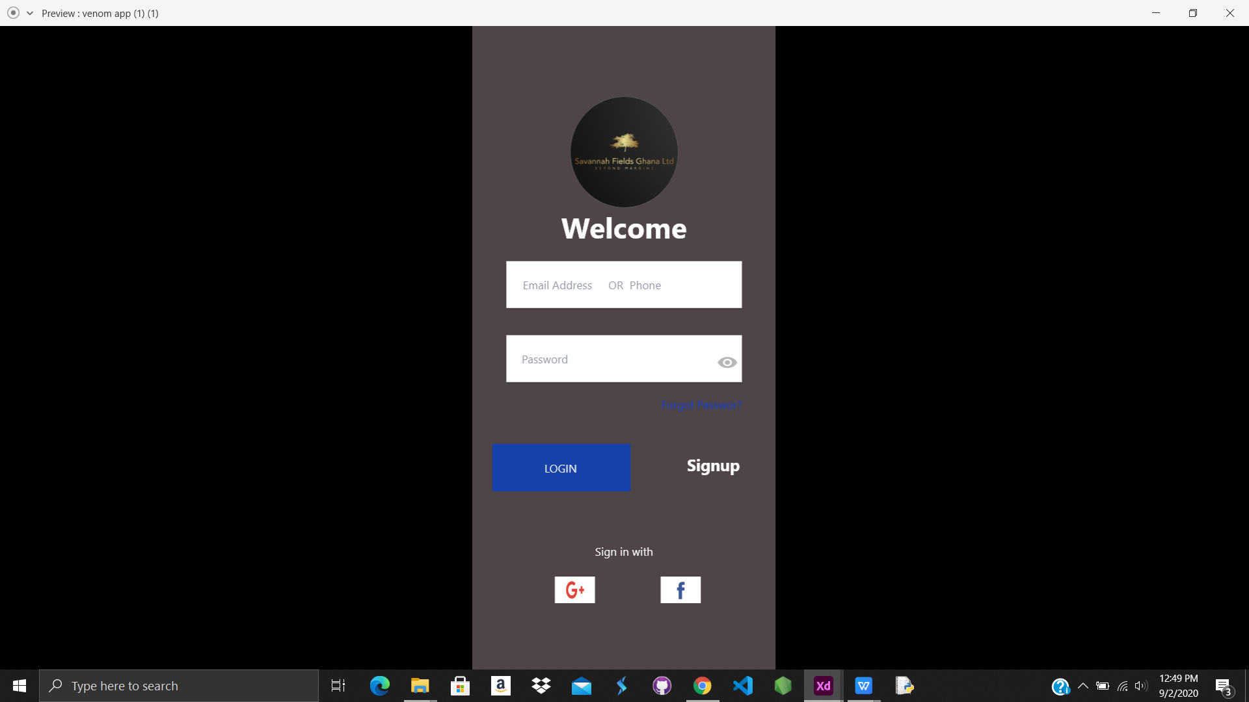
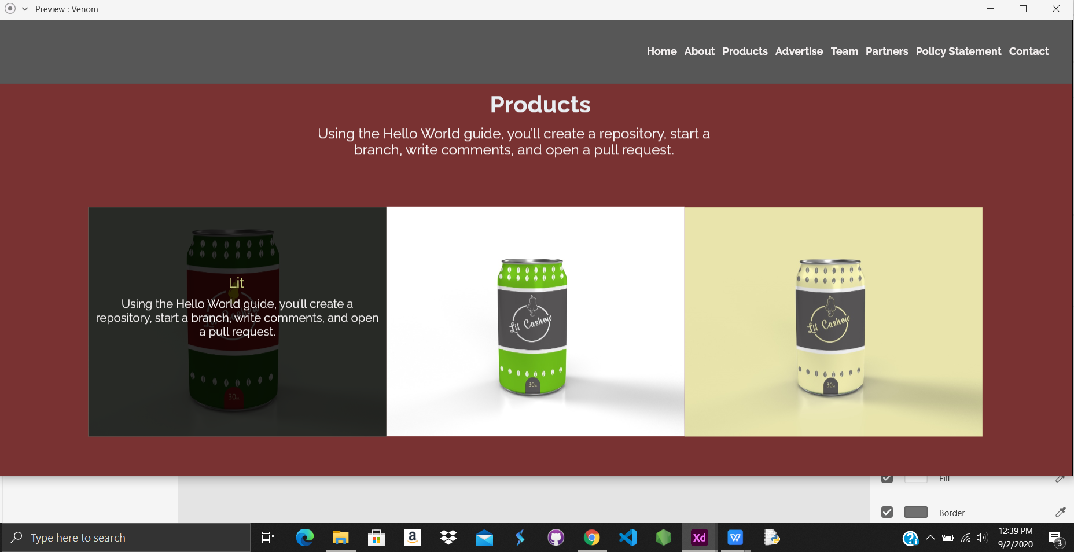
TECHNOLOGY
Web Application
Juicer
Mobile Application

Slide 7

ENTER TITLE
ENTER TITLE
add you text here add you text
add you text here add you text

Slide 8
Marketting Strategy
Social Media Campaign
Promotional discounts
Face to face marketing
The use of Leads
Radio talk show
Leveraging on partner networks such as Agrofeed

Slide 9




OUR COMPETITIVE ADVANTAGE
market info
partner
online market
made in Ghana
Efficiency
Web app
Mobile app
Local
Breweries

Slide 10

BUDGET
We estimate an annual revenue of over GH¢ 100,000.
70% of the revenue will come from fees charged on orders and Commission on products purchased
And the 30% will come from advertisment on our platforms .

Slide 11
OUR ADDS
We need GH¢ 62,000.00 from investors, 10% of our profits for the next 10 years will be given as interest to any willing to invest in us.
Expenses:
Equipment for production include fruit crusher, filter, distillery, packaging
Fair fees and transportation costs
Inventory space for products

Slide 12
PROJECTED INCOME STATEMENT
A
We project to market over 3000 Ltrs in our startup year and will increase to 150,000 Ltrs by 2025.
Add You Text Here Add You Text Here Add You Text Here Add You Text Here
B
ENTER TITLE
C

Slide 13

REVENUE MODEL
Paid advertisement on our platforms.
Transactional fees charged on orders.
Commission on products purchased.

Slide 14








IMPACT

Slide 15


TEAM
Baah Tonkouru David
Co-Founder
Priscilla Kyeremaah
Co-Founder
Technical Supervisor
Marketting Manager

Slide 16





PARTNERS

Slide 17
CONCLUSION
Savannah Fields is here to stay, reduce unemployment, promote cashew production and encourage a clean environment.

Slide 18
THANK YOU

